Slide 1
Accelerating QA Automation with Generative AI
(Transforming Natural Language Test Cases into Executable Code with Qwen 2.5 72B model)
Target Audience: Engineering, D&AI Teams
Presenter: Shalem Raju

Slide 2



Executive Summary
Bridging the gap between Requirements and Code:
The Initiative: We have successfully fine-tuned a state-of-the-art Large Language Model (Qwen 2.5 72B) to automate the conversion of English test cases into executable code.
The Technology: Leveraging high-performance NVIDIA H200 infrastructure to process complex logic and large-scale data.
Business Value: This initiative targets a drastic reduction in manual coding time for QA engineers, ensuring faster time-to-market and higher consistency in test coverage.
English Test Cases
Quen 72B parameter Model
Automation Desk

Slide 3
Advantages
Powered by H200 GPU’s Processing complex logic at enterprise scale.
80% Reduction in Scripting Time.
Both Horizontally and vertically scalable based on demand.

Slide 4
The Business Challenge
Manual translation of requirements is a bottleneck.
Resource Intensive: converting written test plans (English) into code requires significant engineering hours.
Human Error: Manual coding of test scripts introduces the risk of misinterpretation and syntax errors.
Scalability Limits: As product features grow, the testing backlog grows faster than the engineering team can scale.

Slide 5
The AI Solution
A Custom-Trained Enterprise Model.
Model Architecture: We utilized Qwen 2.5 72B, a leading open-weight model known for superior coding and reasoning capabilities, rivaling proprietary models like GPT-4.
Specialized Fine-Tuning: Unlike generic "chatbots," this model was trained specifically on English-to-Code pairs, creating a specialist tool for our specific domain.
Infrastructure: Deployed on NVIDIA H200 GPUs, ensuring rapid training and near-instant inference speeds for high-volume workloads.

Slide 6
Strategic Advantages
Why this approach wins.
Data Privacy & Security: By fine-tuning our own model rather than sending data to a public API, we maintain 100% control over our proprietary test data and code.
Domain Specificity: The model learns our coding standards and our specific testing frameworks, delivering code that is ready to run without heavy editing.
Operational Efficiency: Engineers shift from writing boilerplate code to reviewing and approving AI-generated scripts, multiplying their productivity.

Slide 7
Impact & ROI
Measuring Success.
40-60% Reduction in time required to generate initial test scripts.
Standardization of code output across distributed teams.
Accelerated CI/CD Pipelines due to faster test creation cycles.

Slide 8
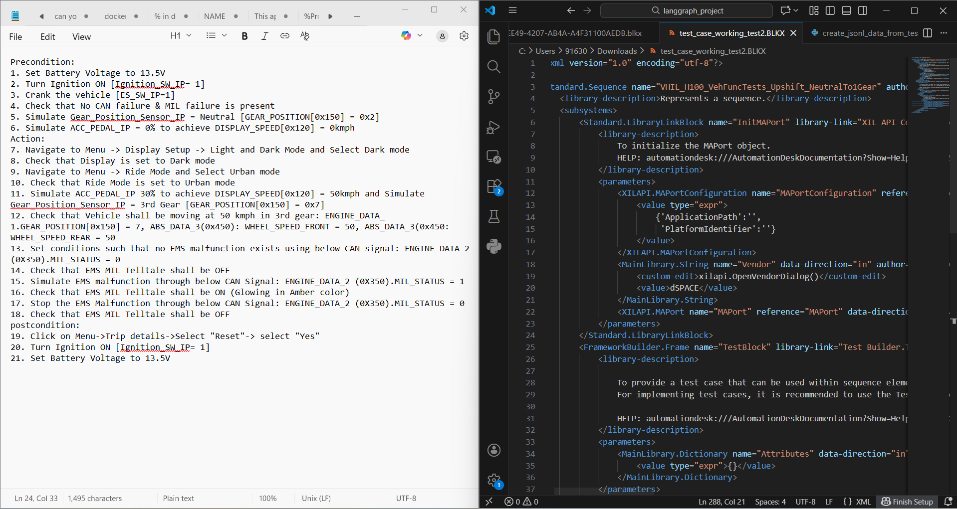
Future Roadmap
Scaling the Capability.
Phase 1 (Completed): Model fine-tuning and validation on H200 hardware.
Phase 2 (Current): Integration into the developer IDE/Workflow and documentation.

Slide 9
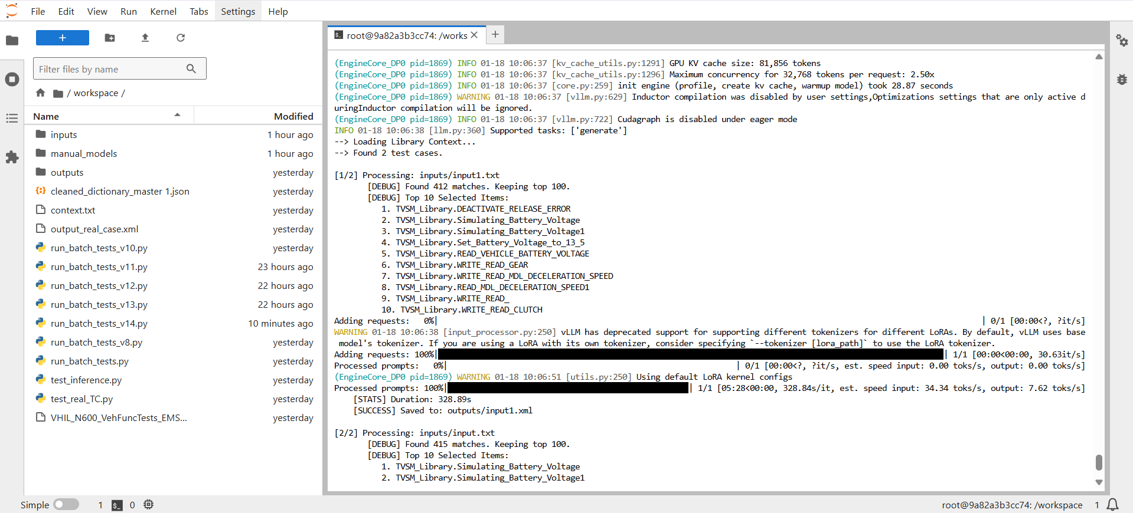
Progress Snapshots.

